Slide 1

Parachuting web app
By Sparta Bois
Muhammad Daaboul
Maksymilian Hadys
David Joyce
Driss Baouali
Ellis Witten
Pun Kai Chan
Thomas Wolstencroft

Slide 2
Introduction
Objective: building a parachuting app that fulfills all requirements and more
Scrum framework
Backlog: Trello
Daily Scrum: User stories & acceptance criteria, Wireframe

Slide 3
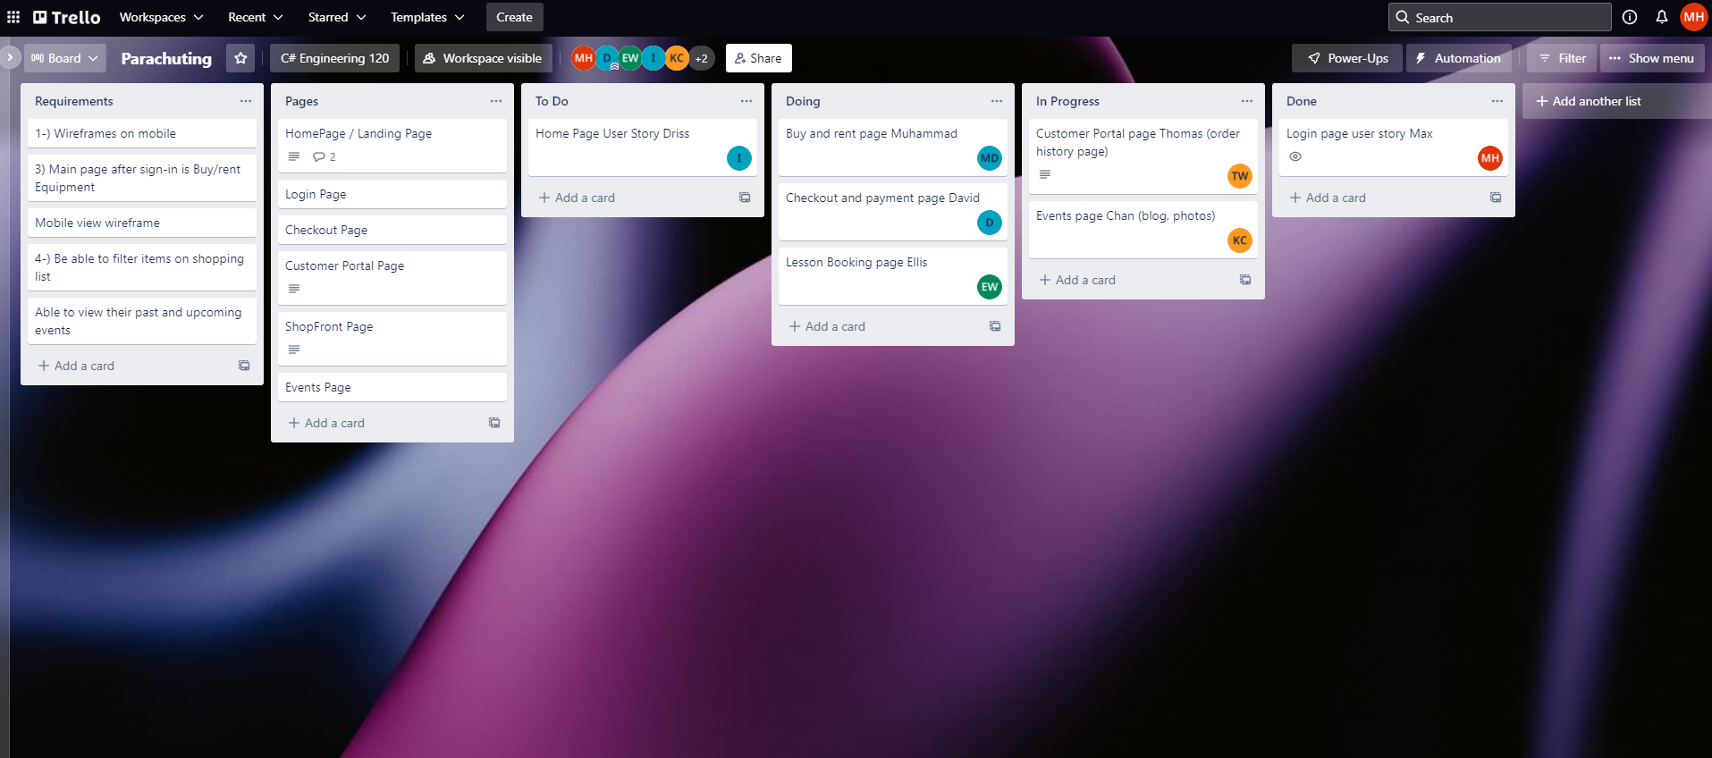
Trello

Slide 4
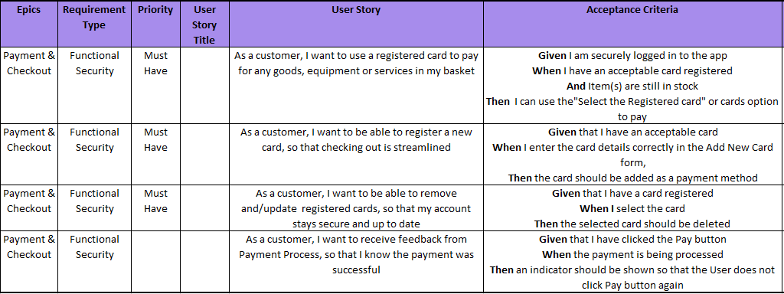
User Stories
Payment & Checkout
As a customer, I want to use a registered card to pay for any goods, equipment or services in my basket
As a customer, I want to receive feedback from Payment Process, so that I know the payment was successful

Slide 5
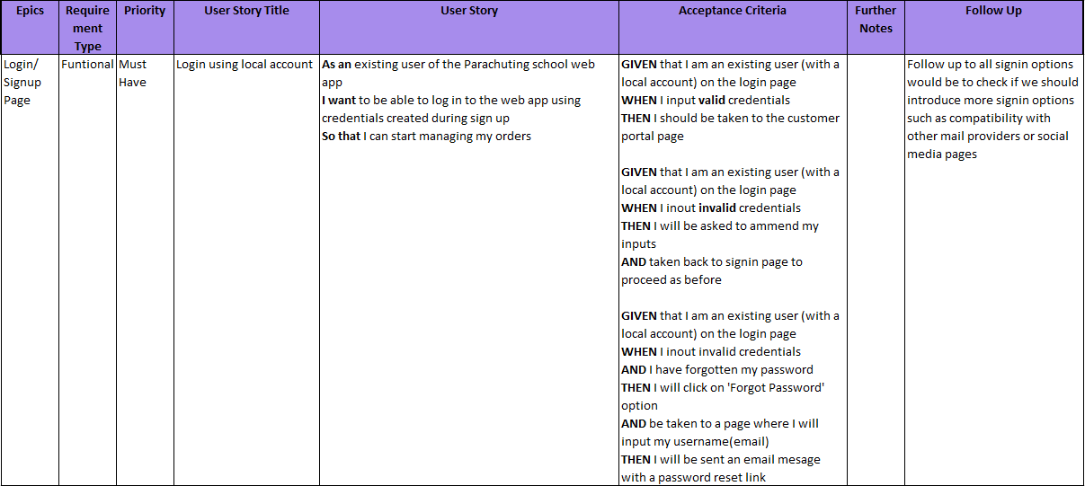
Acceptance Criteria

Slide 6
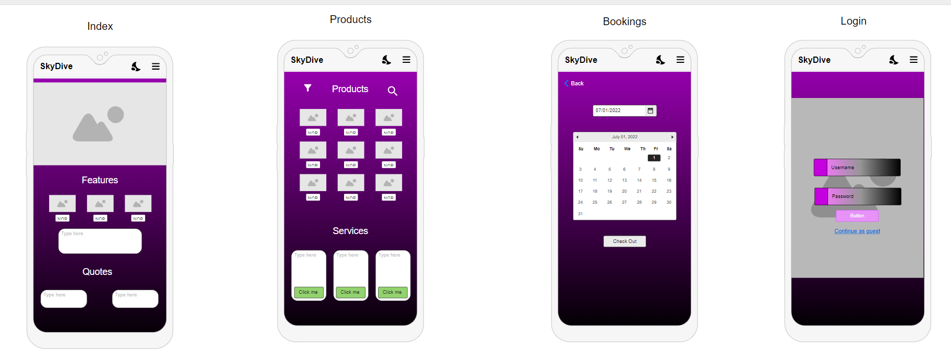
Wireframes

Slide 7
Summary
Teamwork.
Reviewing the Project.
Our experiences.

Slide 8
Thank you for listening! Any questions?

